Slide 1



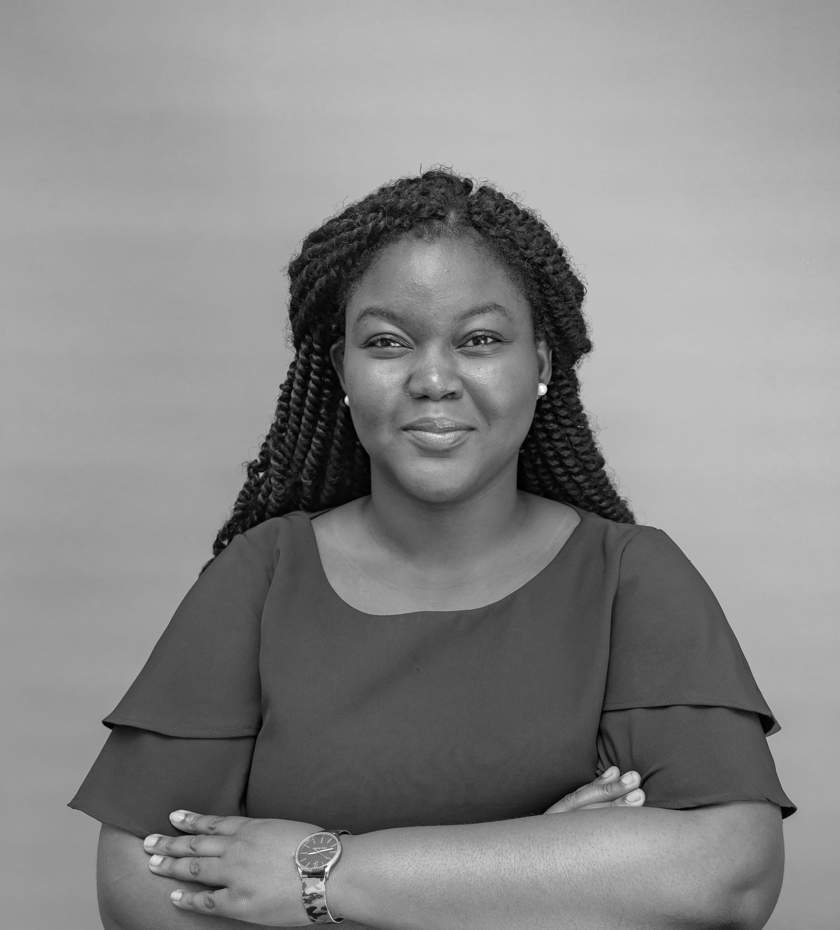

Adjoa Kudoadzi – Analyst
Professional experience
Education and skills
4 months with Africa Foresight Group
Conduct primary and secondary research
Support business development activities
Built a strategy for executing a personal social responsibility
1 year with Ghana School Feeding Program
Conducted/performed weekly trend analyses on the performance of treasury bills and other monetary instruments
Provided timely assistance to the Operations Department Head to ensure smooth payment of caterers contracted by the program
Assisted in the planning of training programs for caterers in conjunction with WFP and UNICEF
6 months with Ministry of Finance
Served as a secretary to a 15-man committee tasked with drafting a report on Illicit Financial Flows in Ghana for the African Union’s Report on Illicit Financial Flows
Coordinated and organized a workshop on drafting Ghana’s Unclaimed Assets Bill
Adjoa holds an BA in Economics from Wellesley College.
She also has experience studying at the London School of Economics and the Chicago Booth School of Business
Adjoa speaks English fluently and is able to have basic conversations in Twi
Introduction
Adjoa Kudoadzi is a bright, vivacious individual with a passion for International Development, women's empowerment, and public policy.
I joined AFG because I was intrigued by the opportunity to creatively solve the business problems of leading companies across the African continent.

